Slide 1
Project Benson
MTA Turnstile Ridership Analysis
Group 4
Audrey Baker, Brad Davies, Brad Solomon, Kevin Stern, Will Stokvis

Slide 2
Agenda
Key Takeaways
Background
Approach
Visualization & Takeaways
Recommendations
Technical Appendix

Slide 3
Key Takeaways
Consider both raw ridership (“The Big 3”) but also the effect of demographic weighting (“ancillaries”).
Focus on March: ridership increases monotonically as weather gets warmer.
Don’t waste resources: ridership dips Fridays & plummets Sat/Sun.

Slide 4
Background

Slide 5
Project Objective
Objective: Provide a granular, actionable breakdown of subway station entry patterns, yielding station-time combinations to optimize WTWY’s volunteer placement.
"Station-time": the number of entrants for each station in each 4-hour period.
▶️ Example: Grand Central-42 St. clocked ~27k entries on 3/31/17 between noon-4pm.
Notes:
Mention Q1 2017 – Q1 2018 here.

Slide 6
Problem Statement
Key challenges:
Data quality issues:
Implausible "jumps" in implied ridership*
Arbitrary "resetting" of ridership counts.
Duplicated entries
Poor field documentation (lack of clarification on field hierarchy)
* On 1-22-17 at 12:00:00, the 14th St 01-03-00 turnstile (N078 R175 ACEL) had 8,476,560 cumulative entries. The next recorded entry figure was 2,130,669,389 cumulative entries, 4 hours later at 16:00:00, implying a 4-hour difference of 2.1 billion riders.
* On 1-22-17 at 12:00:00, the 14th St 01-03-00 turnstile (N078 R175 ACEL) had 8,476,560 cumulative entries. The next recorded entry figure was 2,130,669,389 cumulative entries, 4 hours later at 16:00:00, implying a 4-hour difference of 2.1 billion riders.
* On 1-22-17 at 12:00:00, the 14th St 01-03-00 turnstile (N078 R175 ACEL) had 8,476,560 cumulative entries. The next recorded entry figure was 2,130,669,389 cumulative entries, 4 hours later at 16:00:00, implying a 4-hour difference of 2.1 billion riders.

Slide 7
Field hierarchy
LINENAME
STATION
C/A
C/A
UNIT
UNIT
UNIT
UNIT
SCP
SCP
SCP
SCP
SCP
SCP
SCP
SCP
Split-apply-combine:
Find total entries at 4-hour intervals at the turnstile (SCP) level.
Aggregate back up to the station level (LINENAME/STATION/CA).
~2.3 million turnstile + timeslot records
Notes:
Alternate names: UNIT == REMOTE; CA == BOOTH.

Slide 8
Approach

Slide 9
Data Sources
Core dataset:
~2.3 million records (turnstile+time pairs).
Spanning Jan 7, 2017 thru Mar 31, 2017.
Discrete differences @ 4hr intervals. (0:00, 4:00, …)
External datasets leveraged to find stops with favorable demographic concentrations:
Subway Census Tract Data.
2012-16 American Community Survey 5-Yr Estimates

Slide 10
Visualization & Takeaways

Slide 11
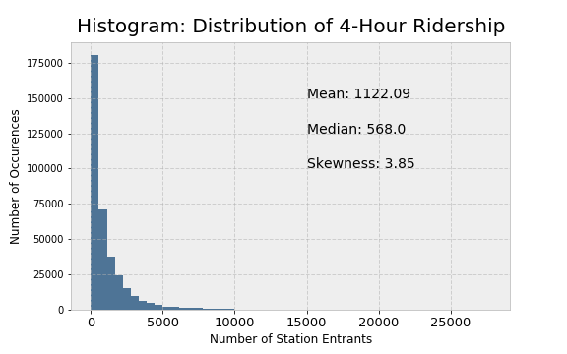
Ridership chunks display rightward skew

Slide 12
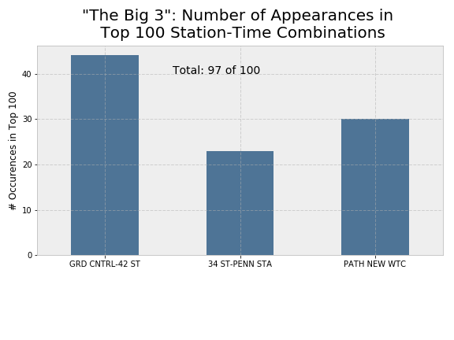
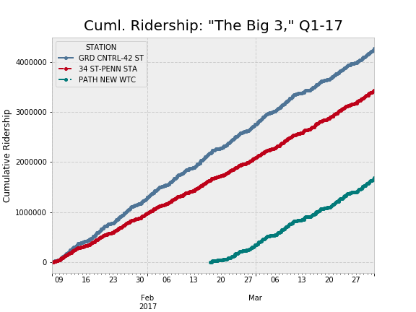
“The Big 3” (Grand Ctrl, Penn Station, PATH WTC)
Notes:
Penn Station: 4-8 am; WTC: all times; Grand Central: rush hour

Slide 13
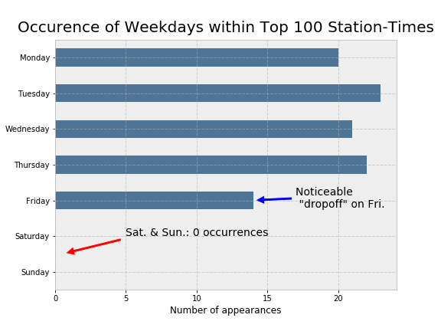
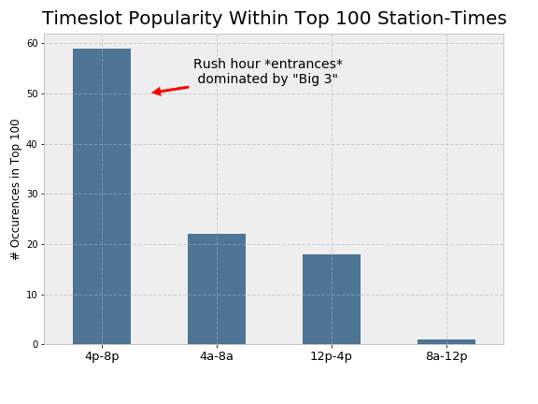
Time-based patterns

Slide 14
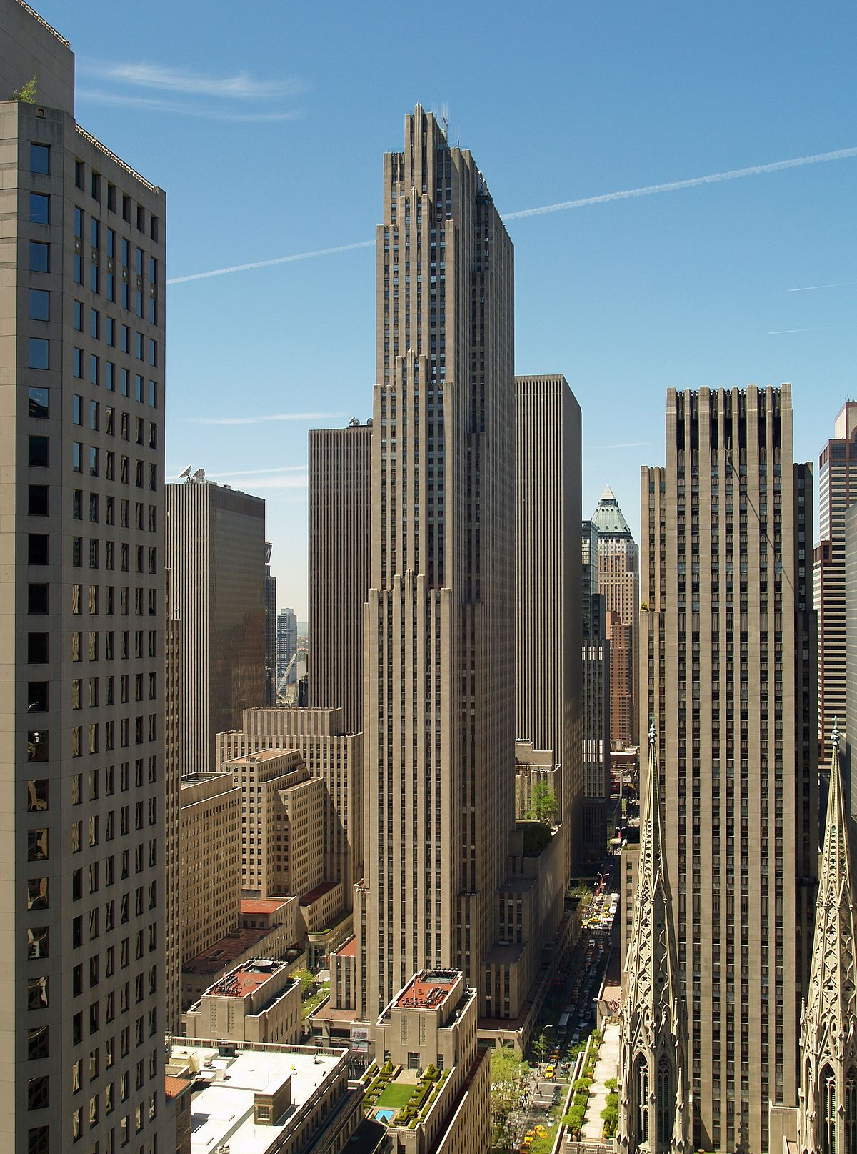
Demographically-driven target areas
Weighting scheme: mean pct. rank of:
Females as % population
Composite education score
Median income
After weighing by demographic scoring, 2 other important locations emerge:
Lexington Av/53 (esp. Wed-Thu 4-8pm & Fri 12-4 pm)
47th-50th Streets-Rockefeller Center (late March)

Slide 15
Recommendations

Slide 16
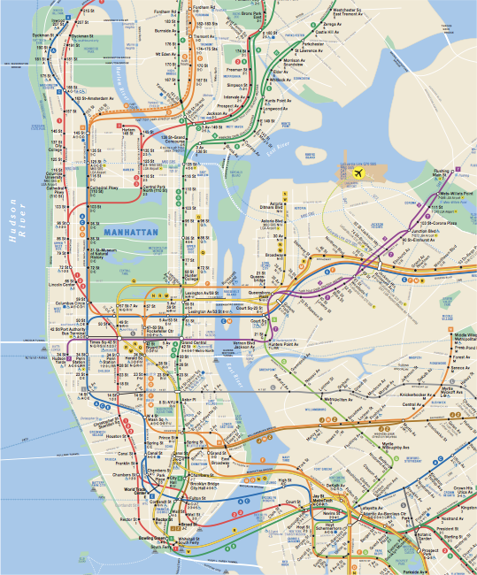
Focal points

Slide 17
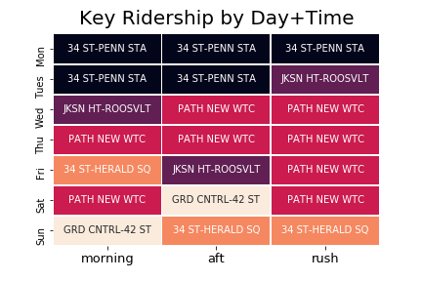
Heatmap: Ridership

Slide 19
Technical appendix

Slide 20
Detecting “true flukes” (not outliers)
As mentioned earlier, we find ~25 entries that can be deemed “unrealistic” and are removed from the dataset. (25,000+ entrants to one turnstile within 4 hours.)
However, we also find “legitimate” entries where 4-hour entry tallies are as high as the 2,500-3,500 range. (3,500 turnstile entrants in 4 hours would imply 1 entrant every 4.11 seconds.)

Slide 21
A note on memory usage
We reduce the memory footprint of our raw dataset by a factor of 3.5x, from 783.60 MB to 224.12 MB through use of categorical datatypes and integer downcasting.
Pandas pd.categorical dtype maps raw values to integer values, using an optimized int subtype but retaining unique representation.
Notes:
https://pandas-docs.github.io/pandas-docs-travis/categorical.html#memory-usage

